Slide 1
Quick Reports
Jesse Williams, James Jasinski, Matthew Coleman

Slide 2
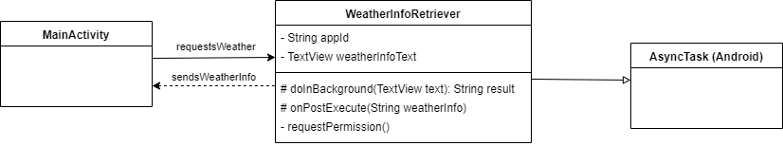
Weather API
Call occurs on startup of the Main Activity
Background process requests permission to use location
Gets coordinates via GPS and makes an OpenWeatherMap API call
Parses the response for info and updates the designated text

Slide 3
Database Module
First runs and creates the database the first time the application is run. The database then persists from then on.
Implementation completed using the Room database system.
Contains two tables, the Image table and the Report table. Also has a DAO (Data Access Object) for each of the tables.
The following slide contains the UML diagram for the database module.

Slide 4
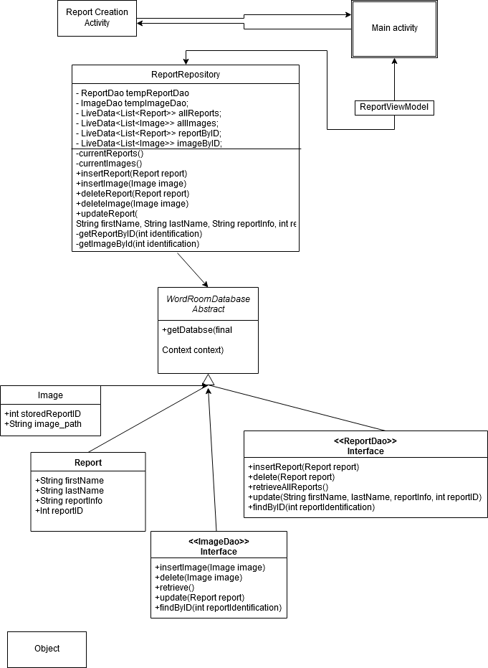

Slide 5
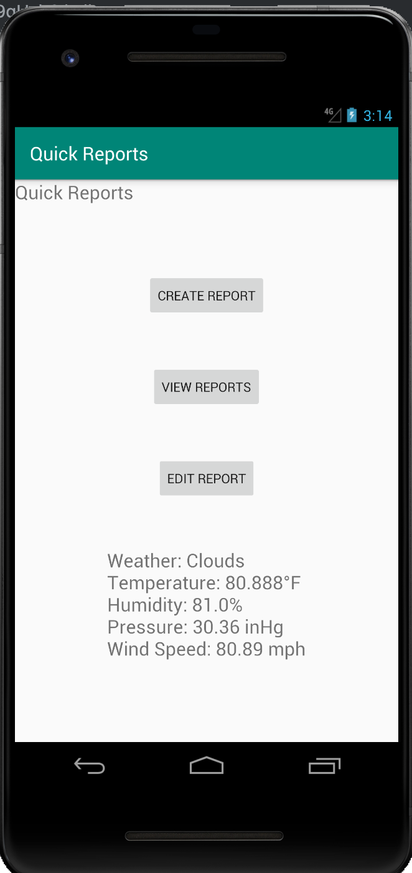
The UI
A helpful UI
A user friendly UI

Slide 6
